Slide 1
Lecture 5 - Graph
Gilbert.Lau@DataStax.com
Partner Architect
+1 408 357 4528
@glau_sf

Slide 2
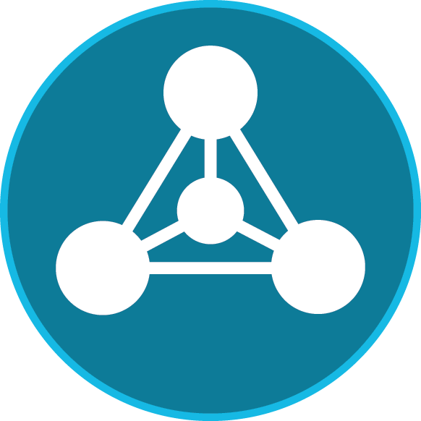
Agenda
Review Graph Market Problems –> Why Graph
Review DSE Graph’s Differentiators –> Why DSE Graph
Review Key Graph Needs of Cloud Application Graph -> DSE Graph Features

Slide 3
Problem(s) That Drive a Graph Database
Databases were built to store Things, not Relationships!
Databases were optimized to extract well defined, mostly static, related things - Join + Index
Hacks were created to handle almost well defined, mostly static, related things - Dynamic Queries
Today’s world is driven by Related Things that are ever changing, constantly expanding, and are doing so rapidly.
1 + 2 = Missed Business Opportunity
The time for the Graph Database has come!
©2016 DataStax Confidential. Do not distribute without consent.

Slide 4
What is a Graph Database?
A database for storing, managing and querying highly connected and complex relationships.
A graph database’s architecture makes it particularly well suited for unlocking the value in the data’s relationships and finding commonalities and anomalies in large data volumes.

Slide 5
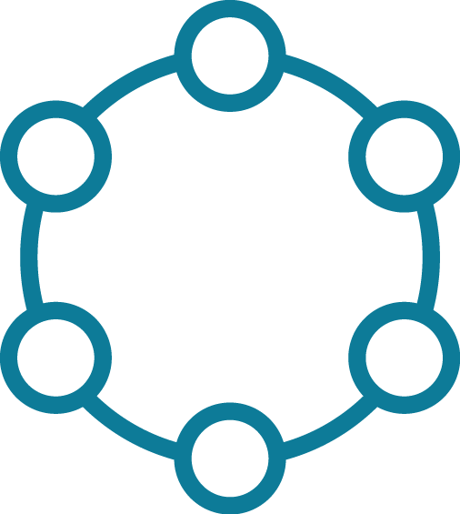
Problem(s) That Drive the DSE Graph Database
The first versions of Graph Databases were focused on …
storing and analyzing related things
offline analysis of graph data
1 + 2 = Market Opportunity for Cloud Application Graph Needs
The DSE Graph Database is the best choice for Cloud Application Graph Problems
©2016 DataStax Confidential. Do not distribute without consent.

Slide 6
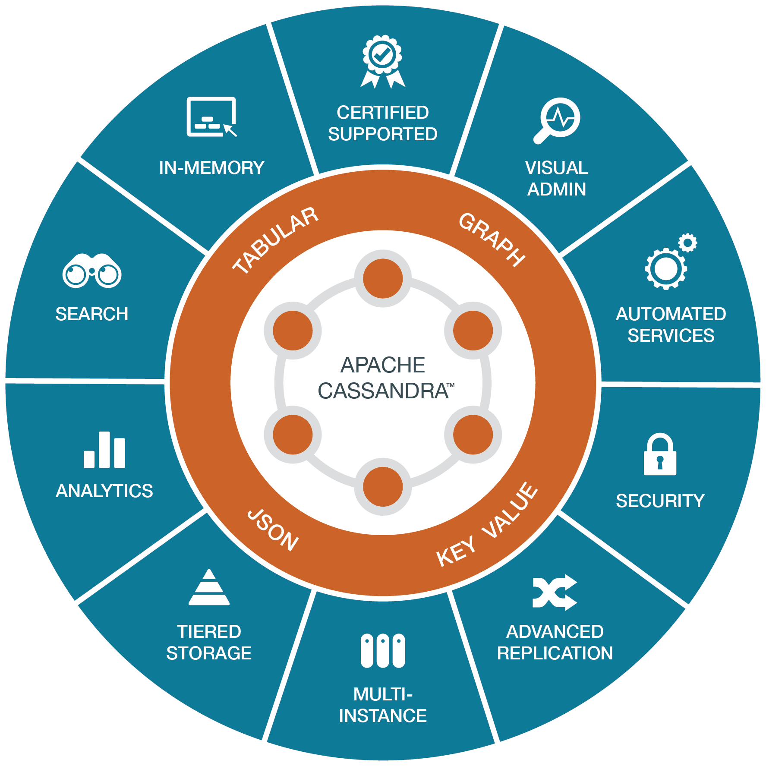
What is DataStax Enterprise (DSE) Graph?
A scale-out graph database purposely built for cloud applications that need to act on complex and highly connected relationships.
Supports a property graph model natively inside the DataStax product, engineered specifically for DataStax Enterprise (Cassandra, Search, Analytics).
Store & find relationships in data fast and easy in large graphs.
Part of DSE’s multi-model platform.
©2016 DataStax Confidential. Do not distribute without consent.

Slide 7
Use Cases
Use Case | Domain Problem | DSE Graph Approach
Customer 360 | How can I smartly understand, navigate, analyze, and act on my Customer data and their relationships that are consolidated across many different systems to get a holistic view of my customer? | Use relationships to connect disparate data sources and provide an always up to date Customer profile to users.
Asset Management | How can I easily perform analysis on numerous relationships that form among data elements and tend to be of much greater interest when examined collectively than reviewed in isolation? | A graph is also a good model for managing network assets (with their properties or configurations) and how they relate to each other over time.
Security/Fraud | How can I quickly determine which entity, transaction or interaction is fraudulent, poses a security risk, or is a compliance concern? | In a complex and highly interrelated network of users, entities, transactions, events, and interactions, a graph database can quickly find the bad needle in a haystack of relationships and events that involve countless financial interactions.
©2016 DataStax Confidential. Do not distribute without consent.

Slide 8
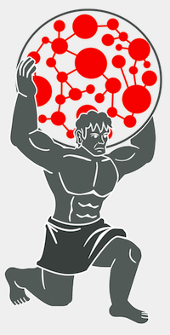
What about Titan?
Titan is a TinkerPop-enabled, scale-out graph database that has a pluggable storage back end option that allows it to persist data to a variety of databases including Cassandra, HBase, and others.
DSE Graph benefits from years of experience with real-world, scale-out graph database use cases implemented against Titan.
While DSE Graph uses Titan as a model, it integrates much more deeply into Cassandra and the DSE platform to provide better consistency and performance as well as additional features.
DataStax does not Sell, Support, or Develop Titan

Slide 9
Cloud Application Needs
Need | DSE Graph Feature
Store and Access Data Quickly | Graph Data Model + Gremlin
Flexible, Fast Application Builds | DSE Graph + DSE Studio & DSE Drivers
Analyze Information | Graph Analytics with DSE Analytics
Search and Find Quickly | Graph Search with DSE Search
Ingest and Export Data | DSE Graph Loader
Secure Information | DSE Security
Manage and Monitor | Opscenter
Availability, Scale, Operational Ease, Performance… | DataStax Enterprise

Slide 10
Property Graph Concepts
DataStax
Edge
DataBricks
☞
Spark
partner
☞
develops

worksFor title: CEO
worksFor title: VP Product

uses
Vertex

reportsTo
manages

worksFor title: CTO
Billy Bosworth
Robin
Schumacher
uses
DSE
reportsTo

Property

develops
Jonathan Ellis
Cassandra

Slide 11
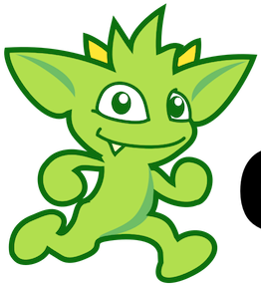
Gremlin
tinkerpop.apache.org
g.V().has("name","gremlin").
repeat(in("manages")).until(has("title","ceo")).
path().by("name")
>> The management chain from Gremlin to the CEO

Slide 12
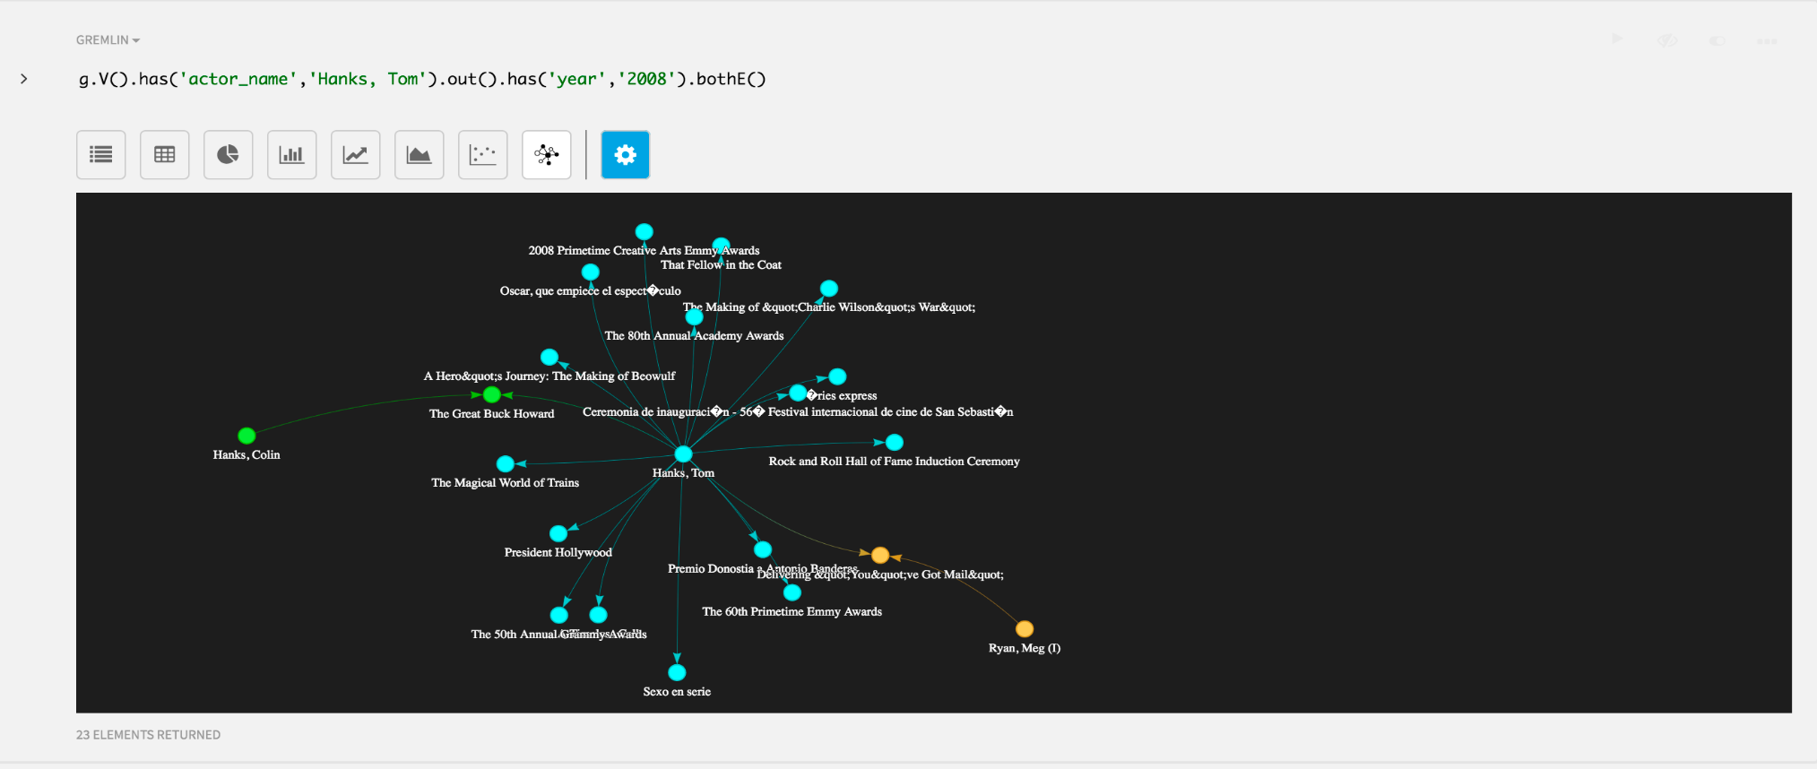
Developer support with DataStax Studio
Web-based developer solution which helps developers visually explore, query, and trouble-shoot DSE Graph in one intuitive UI.
Auto-completion, result set visualization, execution management, and much more.

Slide 13

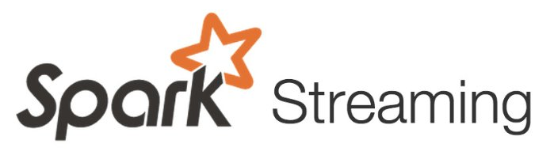
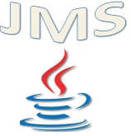
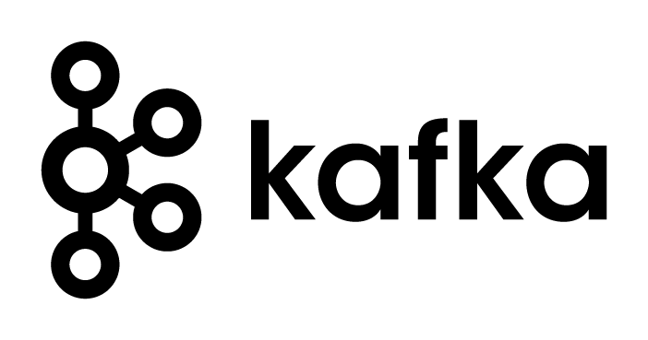
Data Loading Support with DSE Graph Loader
Simplifies loading large amounts of enterprise data from various sources into DSE Graph efficiently and robustly.
Inspects incoming data for schema compliance.
Uses declarative data mappings and custom transformations to handle diverse types of data.
Data Mappings



DSE Graph
Batch Loading
JSON
RDBMS
Graph Loader
Stream Ingestion

Slide 14
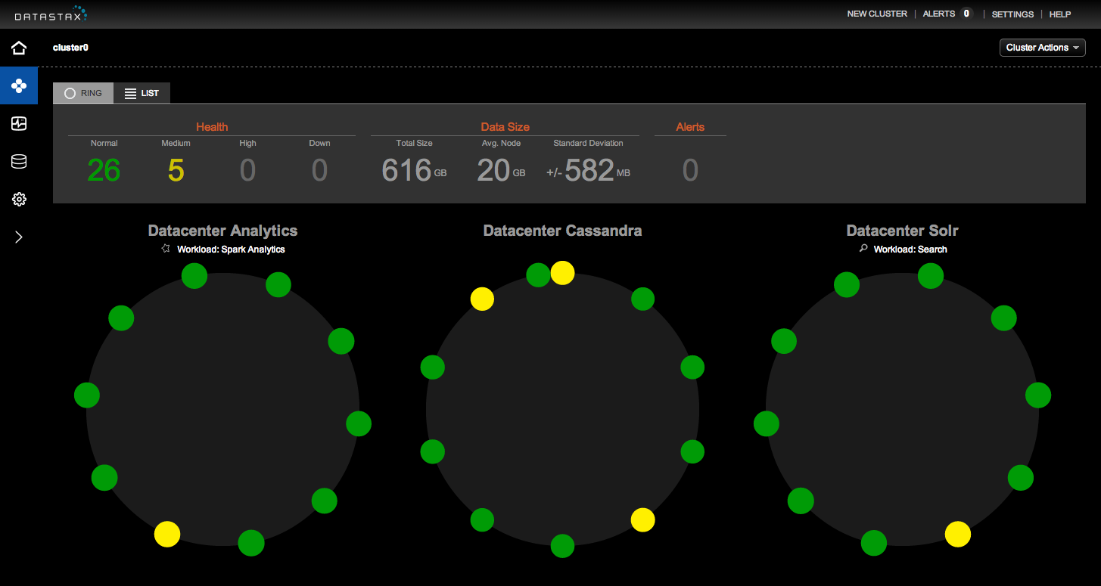
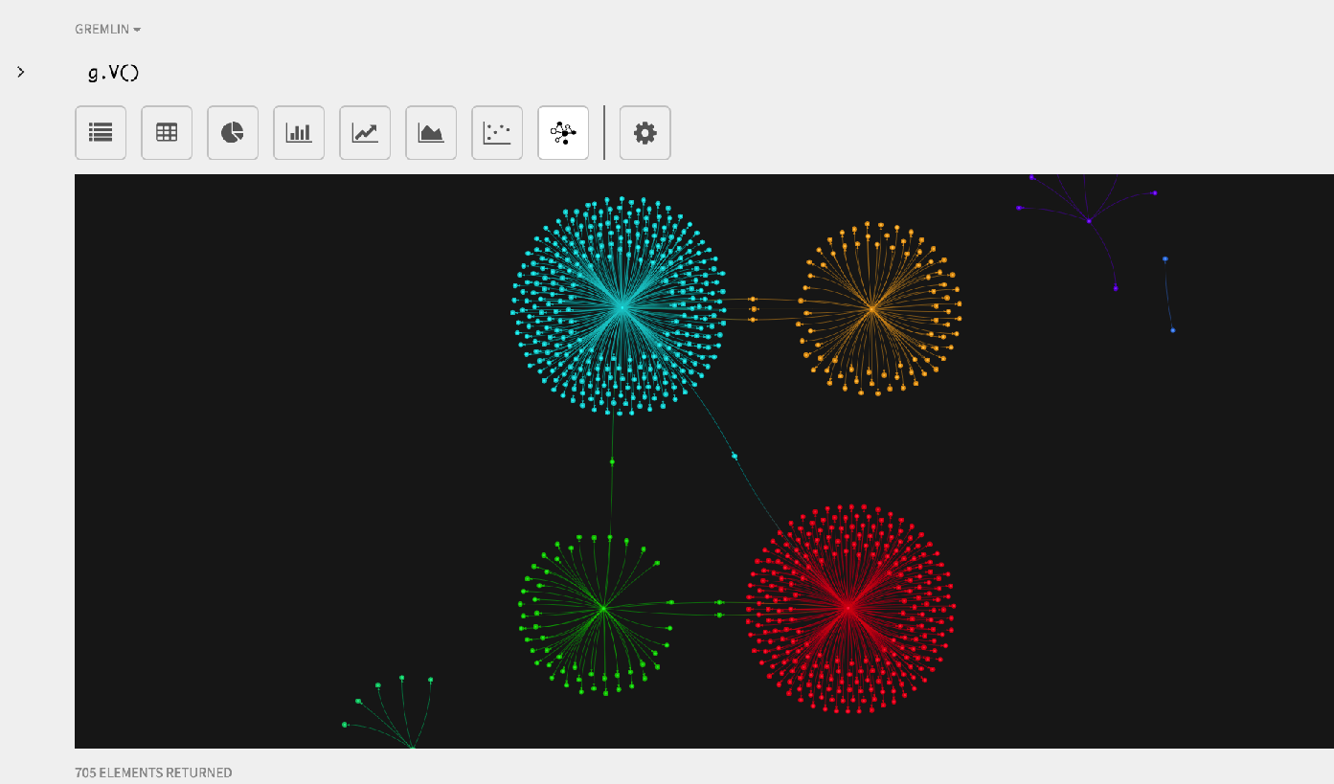
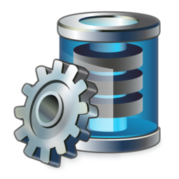
A Complete Integrated Solution for Graph
Server Visual Management/Monitoring
Visual Development Integrated Drivers (CQL, Gremlin, etc.)
Java Python C++ More…

Slide 15
Lab 7 – Graph
https://github.com/DSPN/DataStaxDay

